Slide 1
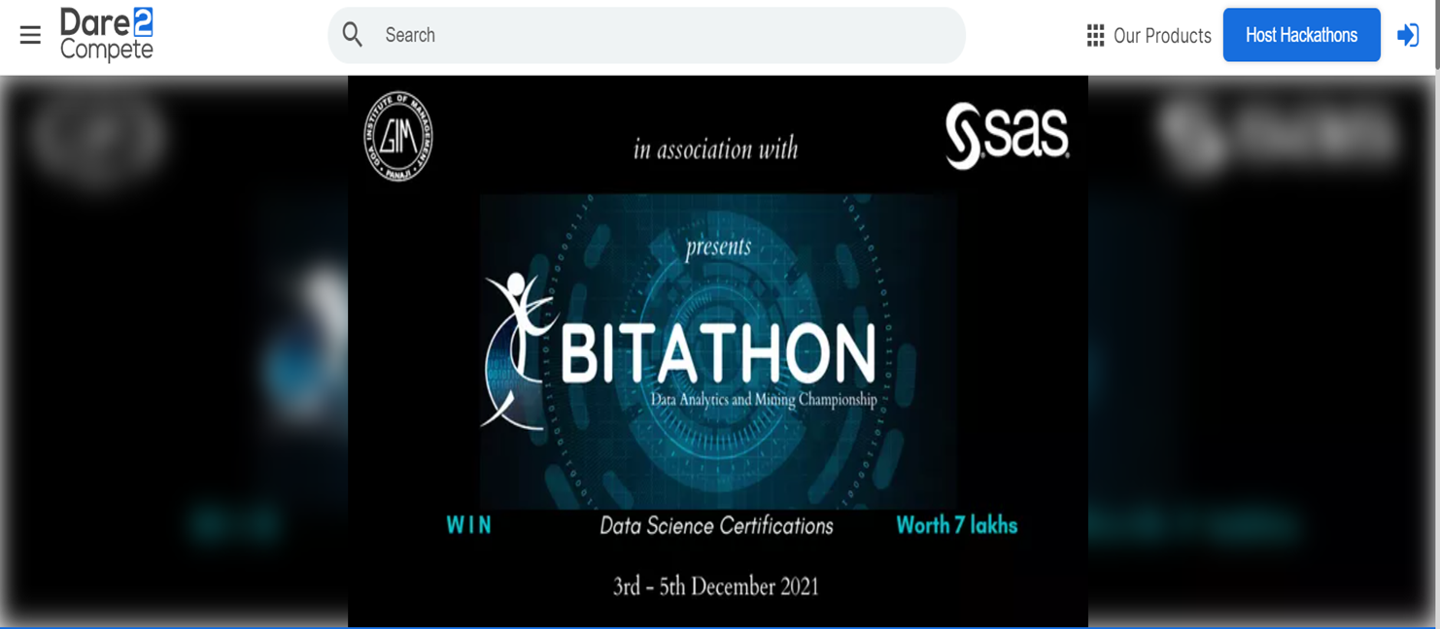
SAS GIM BITATHON Webinar
Problem Context Brief, Demos & Do’s & Don’ts !

Slide 2
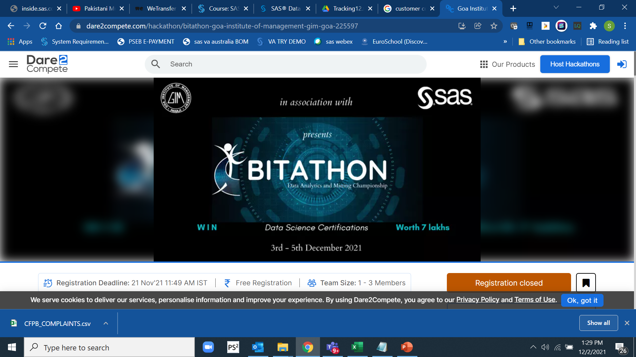

Slide 3
Important Contact
Bitathon
bitathon@gim.ac.in
Contact for Bitathon: Nikhil Tarala: +91 90000 10598
Paulami Sanyal :+91 88200 08402
https://dare2compete.com/hackathon/bitathon-goa-institute-of-management-gim-goa-225597

Slide 4
Agenda
Problem Context Brief
Expected Outcome Formats
Software Involved
Do’s & Don’ts

Slide 5
Agenda
Problem Context Brief

Slide 6



Customer Complaints
Lots of Text !
Requires Intelligent Analysis !
Consumer Financial Protection Bureau

Slide 7
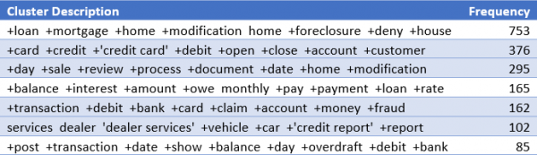
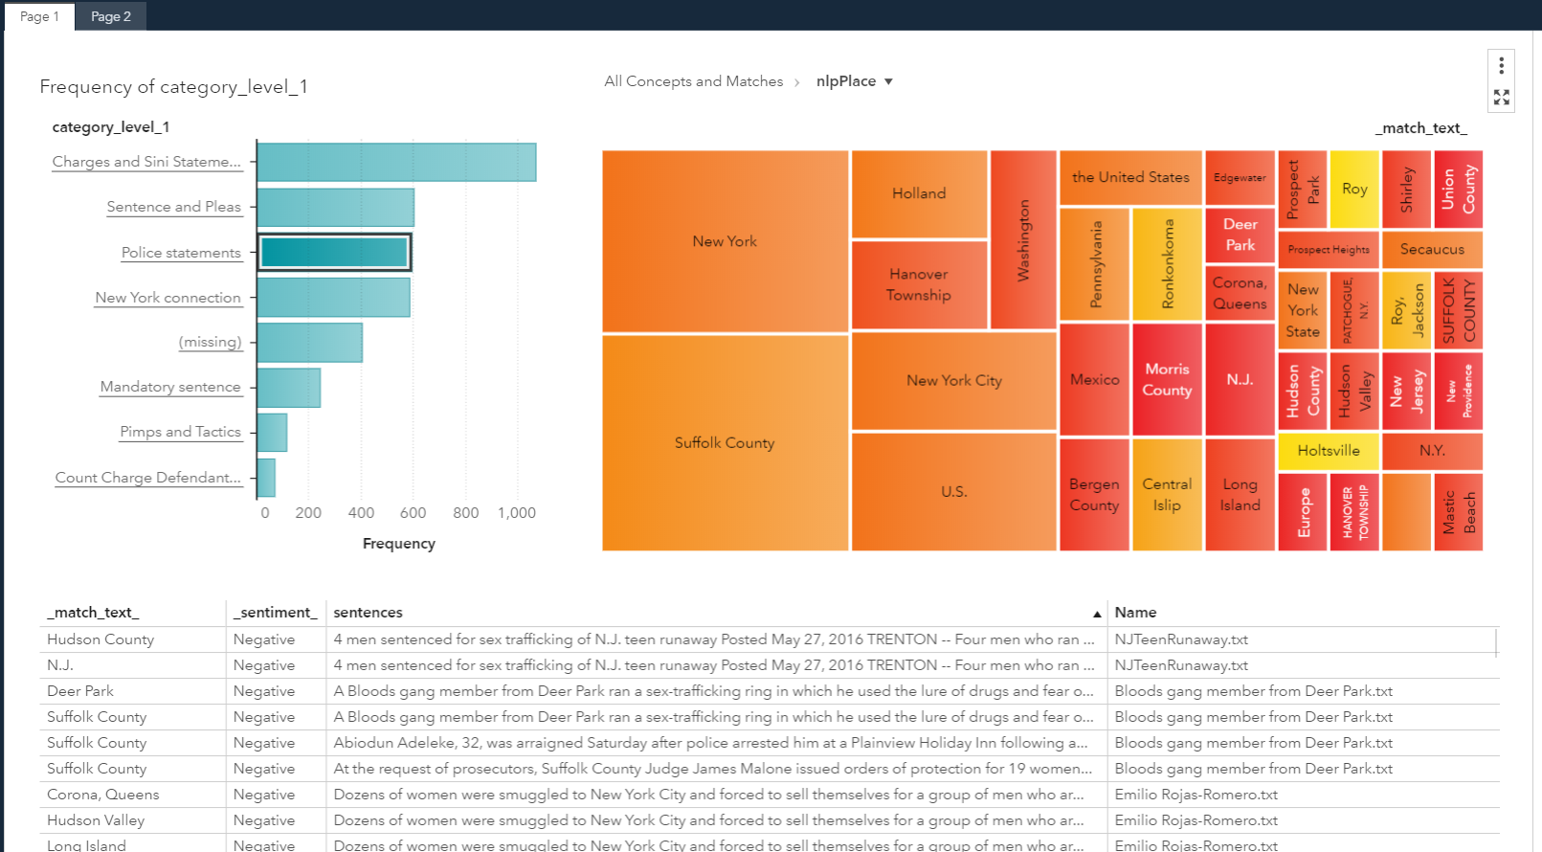
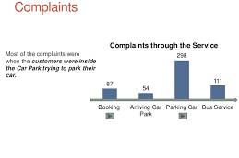
Lots of Data : Analysis, Visualization & Tracking

Slide 8
The Problem Context We provide Dataset & Context !
CONTEXT : BIG PICTURE
>>
The problem is around Customer Complaints, data file have info on data points referring to customer complaints for certain financial products…
You may think of myriad of analysis including data management , Visual or Non-visual patterns , statistical or data mining or Text analysis or ML analysis with a definitive objective to bring out best information out of available data.

Slide 9
References
Good to Know
Submit a complaint | Consumer Financial Protection Bureau
https://www.consumerfinance.gov › complaint
Search the Consumer Complaint Database
https://www.consumerfinance.gov › data-research › sea...
Submit a complaint | Consumer Financial Protection Bureau
https://www.consumerfinance.gov › getting-started
Learn how the complaint process works - Consumer Financial ...
https://www.consumerfinance.gov › complaint › process
Consumer Complaint - Search the Consumer Complaint ...
https://www.consumerfinance.gov › data-research › sea...
Consumer Financial Protection Bureau
https://www.consumerfinance.gov

Slide 10
The Context
>> DATA POINTS : BIG PICTURE
Data from Consumer Financial Protection Bureau.
More than 3000 complaints.
Data points for the complaint text and disputes.
Use the provided file. No need to download any extra file for VFL Users.
No SAS users, download the file available at GIM’s competition site.
Location : Available at VFL , Also, download link available at GIM’s competition site .

Slide 11
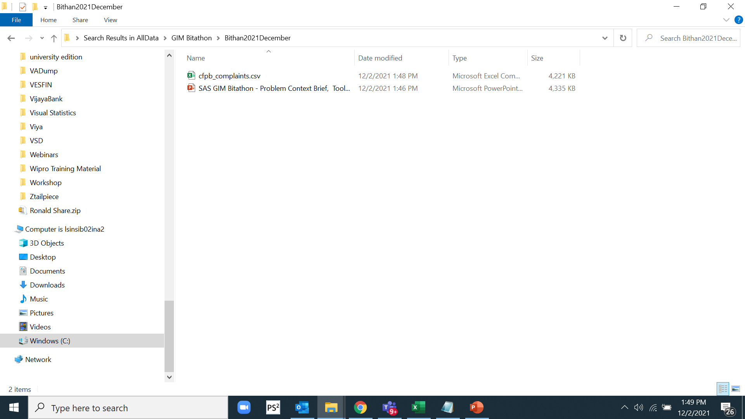
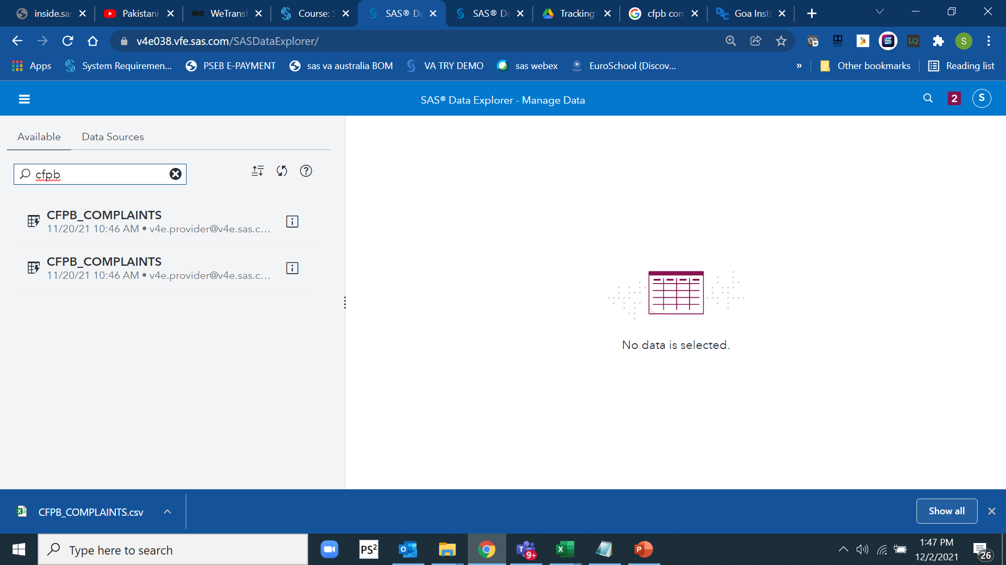
Data Files
One main file:
CSV format for download : Available at :
Inside Viya for Learners:

Slide 12
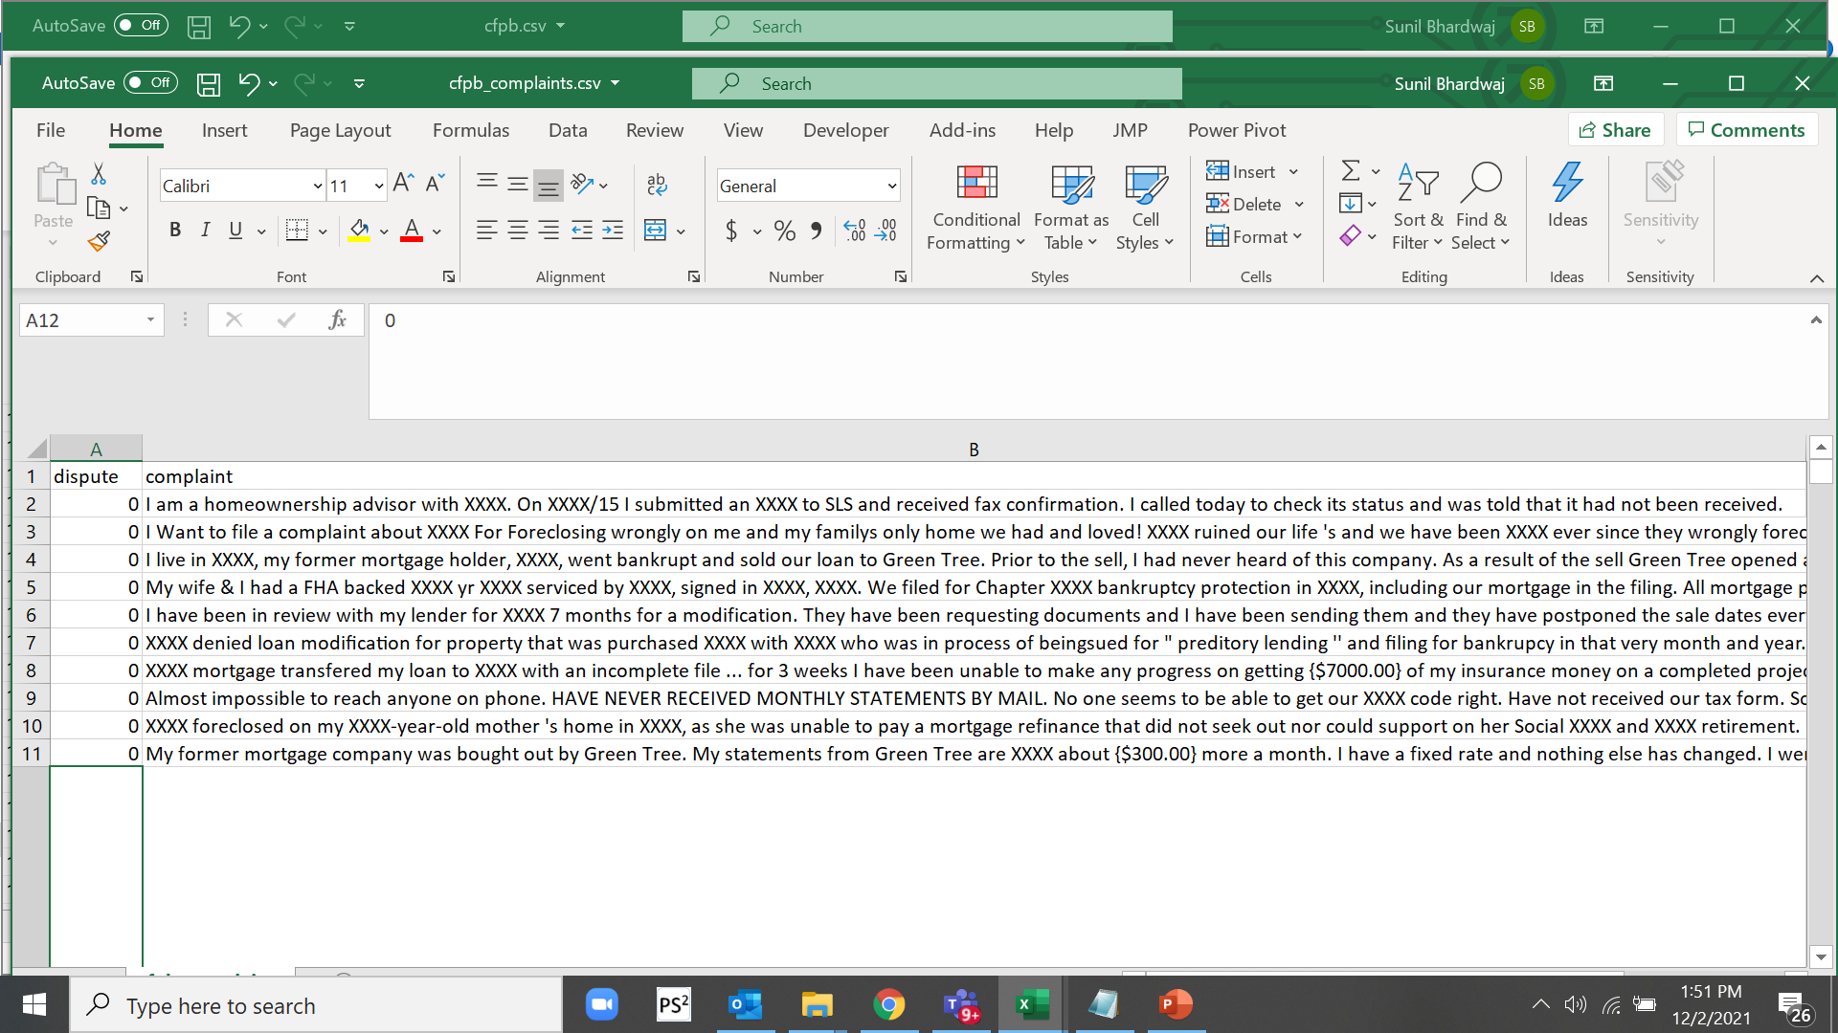
(table_)cfpb_complaints
Table name:
cfpb_complaints
Location:
Preloaded in SAS VFL
Columns:
2
Rows:
3400 +

Slide 13
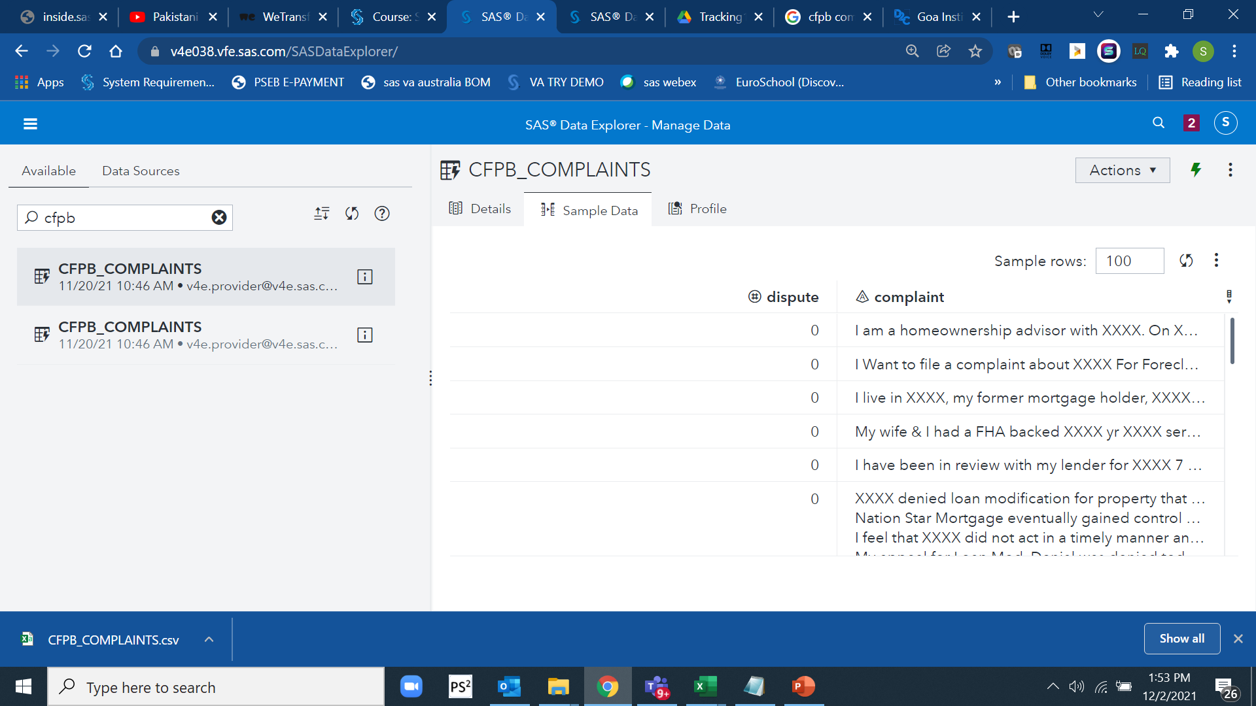
(table_)cfpb_complaints
Table name:
cfpb_complaints
Location:
Preloaded in SAS VFL
Columns:
2
Rows:
3400 +

Slide 14
Download Link
Bitathon_Round 2_Dataset
https://gimgoa-my.sharepoint.com/:f:/g/personal/shalini_singh20b_gim_ac_in/EpERw5ykZypJrd_wPueXRGoBrEsT_GYQbTR87pQEkHMqig?e=VeaIdA
You will be notified with link , if not already !

Slide 15
Data : Key Considerations
This dataset contains self-reported/public reported information through open-source.
May contain meaningless/misspelled/mistyped entries.
It may be present with outliers and other problems
Usage of excel for preliminary and further analysis is not recommended. Use SAS Software/R/Python to handle or analyze these files.

Slide 16
Time & Resource Management
Manage Time & Resource Judiciously
Divide tasks between team members
Practice Software components
Spend time on initial part i.e. formulating your problem statement
Suggested Time for Tool Exploration,
4 - 6Hours
Study Plan , Problem Identification, Data Exploration, Manipulation and Analysis
14-18 Hours
Report Layout and PPT Layouts and Final Report and PPT generation
4- 6 Hours
Recommended Time Distribution
You may plan on your own as well
Separate Instructions to access the software shall be provided

Slide 17
What would be tested ??
Note : Everything depends on your Problem Identification or Analytics Objective .
Be careful , thoughtful and Do not Haste . You may spend a good amount of time here
>> The problem identification or Analytics Objective should allow for testing of following items:
Data Management and Data Manipulation skills
Approach to solve problem in Business Analytics Context
Visualization/Statistical Skills / Text Mining Skills/Machine learning skills
Overall conclusion drawn from the data analysis

Slide 18
What might be evaluated ??
6 Teams will be chosen for Round 3
>> Essentially the assessment is based on the creativity and analytical skills deployed. The evaluation may happen around following steps or activities based on the results and coding steps submitted. These area are largely focused around following key areas:
Data Preparation
Data Visualization and Analysis (Text Mining ??)
Results Consolidation
* Points or Marks Distribution to be shared later

Slide 19
Agenda
Expected Outcome Formats

Slide 20
Approach Note : Important for Round 2
Word Format
15 – 25 pages excluding Appendix
Time Roman , 12 , single spacing preferred
May include Appendix SEPARAETLY, which may have :
Tables, Graphs , Codes, Software screenshots, Equations etc. and any other info
Problem definition / Analytics Objective
Approach:
Data Exploration: data derivation,
data modification, Data Deduction, reductions
Data Analysis:
Results and Conclusions:
Implications:

Slide 21
Approach Note : Round 2 Considerations Total – 100 Marks
Main Headings | Marks | Key Considerations - A generic guideline
Problem definition or Analytics Objective | 10 | Problem Identification Skills & Scope,Depth & Coverage of Identified Problem
Approach Description | 15 | Describe the overall flow , motivations and reasons to adopt the approach
Data Exploration: (Data Manipulation, Data Derivation, Consolidation, Preparation etc.) | 25 | Skills to identify data issues , approach to solve issues , consoidate information out of data, exploratory skills and data prepration strategies
Data Analysis | 30 | Skills to analyse the data , statistical / non statistical skills, descriptive /prescriptive analytical skills, Overall Approach
Results and Conclusions | 10 | Ability to consolidate information from the previous data analysis , linkage to the problem statement and solution description
Implications | 10 | implications of the finding to the relevant stakeholders in society or stakeholders concerned

Slide 22
Presentation – Round 3
Power Point Format
15 – 25 Slides
Decide your own template, format and design
Ten minutes to present max
3-5 mins for Jury Q & A
May include VA based Graphics
For the 10 Teams chosen in Round 2
Presentation and communication skills
Usage of graphics ,
Slide Management
Overall Presentation Storyline
Concluding slides
Q & A by Jury
Duration (generally 12 minutes , followed by Q&A), Flow & Sequence shall be notified later

Slide 23
Round – 3, Presentation – 100 marks
Main Headings | Marks | Genric Considerations
Presentation and communication skills | 25 | confidence , language & connect with the audience
Usage of graphics | 10 | Usage of graphs , visuals etc. to prove or disapporve a point
Slide Management | 5 | Slide sequencing , information distribution , time distribution
Overall Presentation Storyline | 20 | Ability to create a logical connect from statement to the conclusion
Concluding slides | 15 | Concluding remarks , emphatic and definitive comments
Q & A by Jury | 25 | Ability to handle questions , alertness & assertiveness

Slide 24
Who is the Winner ?
Round 2 Marks (70 %) + Round 3 Marks (30 %) = Total (Top Teams )
Jury Decision is Final and Irrevocable

Slide 25
Upload Link
Bitathon Team shall provide you with link !
If not already !

Slide 26
Agenda
Software Involved

Slide 27
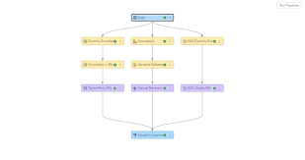
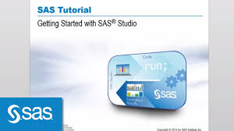


What skill sets might be required ??
For preparation candidates are advised to build skills and awareness of following skills:
SAS Studio Usage : SAS Data step programming including merge statements ,SAS Procs for modelling and Interpretation
SAS Machine Learning using SAS Model Studio
SAS Visual Analytics

Slide 28
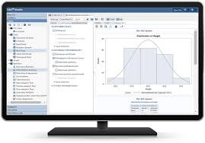
SAS Studio
It's the foundation for all SAS software. Along with an easy-to-learn, flexible programming language, you get a web-based programming interface; ready-to-use programs for data manipulation, information storage and retrieval, descriptive statistics and reporting; a centralized metadata repository; and a macro facility that reduces programming time and maintenance headaches.
https://video.sas.com/category/videos/sas-studio

Slide 29
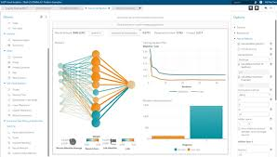
SAS Model Studio
SAS Model Studio is a web-based platform includes a suite of integrated data mining tools to facilitate end-to-end data mining analysis. Model Studio can be used with SAS® Visual Data Mining and Machine Learning, SAS® Visual Forecasting, or SAS® Visual Text Analytics.
https://video.sas.com/category/videos/model-studio

Slide 30
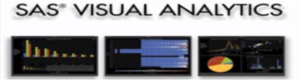
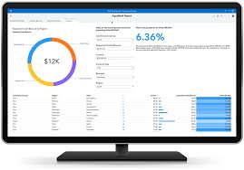
SAS Visual Analytics
Visually explore critical drivers for making better decisions. Find out why something happened. Examine all options and uncover opportunities hidden deep in your data. Automatically highlight key relationships, outliers, clusters and more, revealing vital insights that inspire action.
https://video.sas.com/category/videos/sas-visual-analytics_

Slide 31


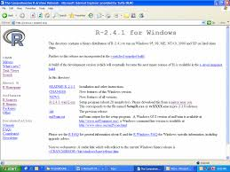
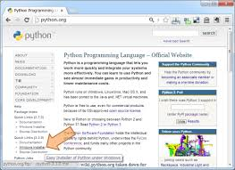
R & Python
https://cran.r-project.org/
https://www.python.org/

Slide 32
Do’s & Don’ts

Slide 33
Important Note - Do’s & Don’ts
Open source in the competition is allowed (R and Python)
Commercial software SAS and its variants allowed.
Excel may be used only for preliminary analysis but discouraged for modelling purposes
No e-mail access or data transfers to outside world during night or day
Unfair means , indiscipline , non-cooperation , insults to other teams etc. shall lead to disqualification
Cross-team discussions not encouraged
No chance to influencing the mentors or jury members inside or outside premises
Option to quit before time though not encouraged or suggested
Decision of jury to be final and binding , no appeals or repeals .
Manage Time & Resource Judiciously
Divide tasks between team members
Practice Software components
Spend time on initial part i.e. formulating your problem statement

Slide 34
Important Contact
Bitathon
bitathon@gim.ac.in
Contact for Bitathon: Nikhil Tarala: +91 90000 10598
Paulami Sanyal :+91 88200 08402
https://dare2compete.com/hackathon/bitathon-goa-institute-of-management-gim-goa-225597

Slide 35


All the Best !!

